Slide 1

Malignant Comments Classifier

Slide 2
Problem Statement
The proliferation of social media enables people to express their opinions widely online. However, at the same time, this has resulted in the emergence of conflict and hate, making online environments uninviting for users. Although researchers have found that hate is a problem across multiple platforms, there is a lack of models for online hate detection.
Online hate, described as abusive language, aggression, cyberbullying, hatefulness and many others has been identified as a major threat on online social media platforms. Social media platforms are the most prominent grounds for such toxic behaviour.
There has been a remarkable increase in the cases of cyberbullying and trolls on various social media platforms. Many celebrities and influences are facing backlashes from people and have to come across hateful and offensive comments. This can take a toll on anyone and affect them mentally leading to depression, mental illness, self-hatred and suicidal thoughts.
Continued……………

Slide 3
Internet comments are bastions of hatred and vitriol. While online anonymity has provided a new outlet for aggression and hate speech, machine learning can be used to fight it. The problem we sought to solve was the tagging of internet comments that are aggressive towards other users. This means that insults to third parties such as celebrities will be tagged as unoffensive, but “u are an idiot” is clearly offensive.
Our goal is to build a prototype of online hate and abuse comment classifier which can used to classify hate and offensive comments so that it can be controlled and restricted from spreading hatred and cyberbullying.

Slide 4
About Dataset
There are 159571 rows and 8 columns in the train dataset.
There are 6 column which are of int type.
There are 2 columns which are of object type.
There is no null value in the dataset.
‘Id’ contains id of each row which is not useful for model. So, drop it.
Now the trained dataset contains 159571 rows and 7 columns.
There are 153164 rows and 2 columns in the test dataset.
Both these columns are of object type.
There is no null value in the dataset.
‘Id’ contains id of each row which is not useful for model. So, drop it.
Now the test dataset contains 153164 rows and 1 column.

Slide 5
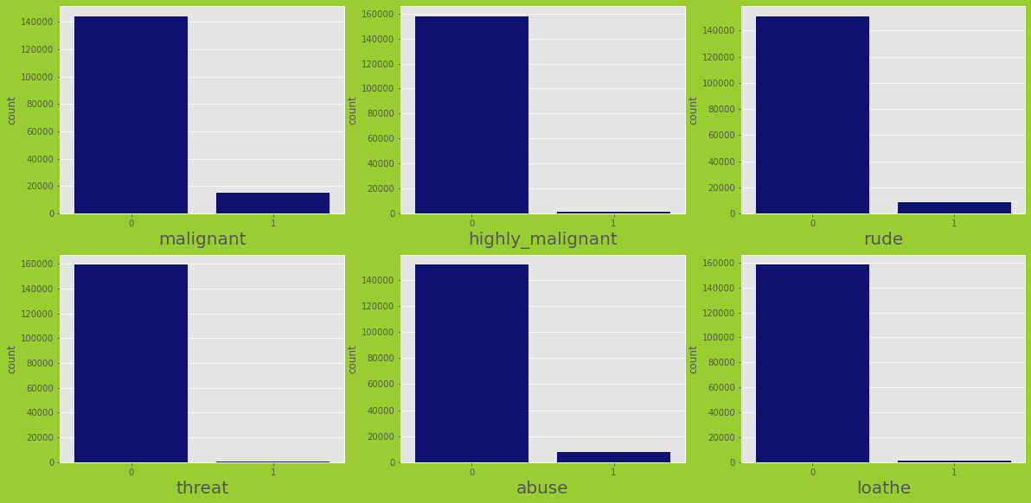
Exploratory Data Analysis
a).Univariate Analysis:

Slide 6
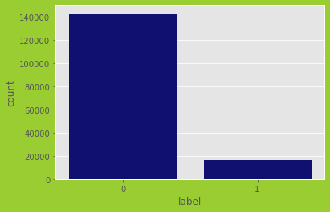
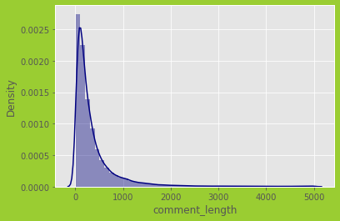

Slide 7
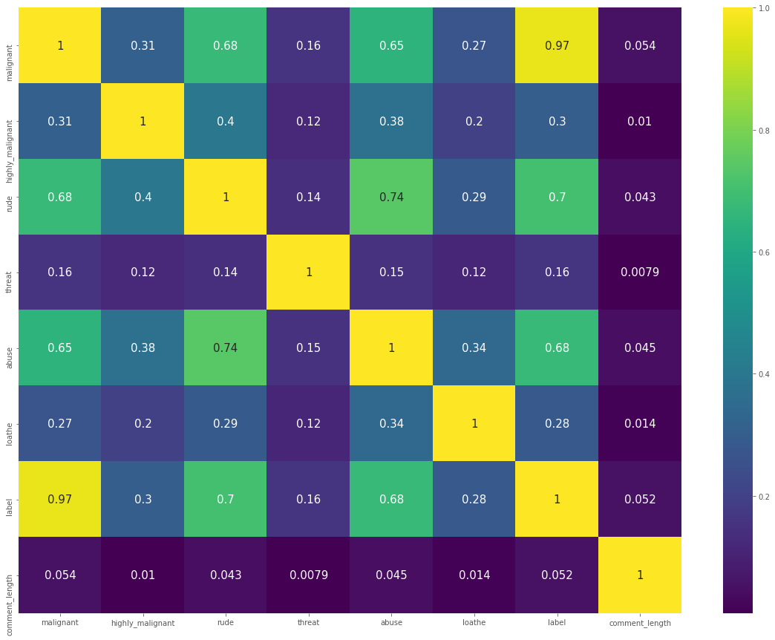
Correlation matrix using Heatmap

Slide 8
Features Engineering
Data Processing
Data Cleaning
Dealing with Outliers
Outliers are not present.
Dealing with Skewness
Skewness is in categorical columns, so no need to worry about it.

Slide 9
Model Initiating
Find best Random State
Split dataset using Train_Test Split
Model Building
Accuracy Score
Cross-Validation Score
ROC_AUC Curve
& Score

Slide 10
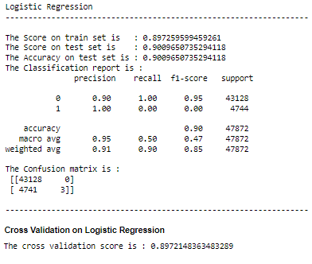
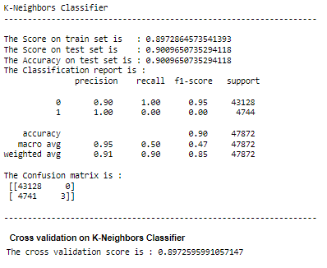
Insights of all Models
Continued…………….

Slide 11
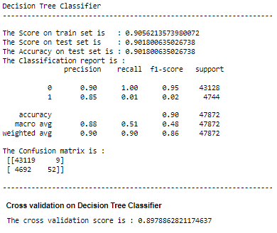
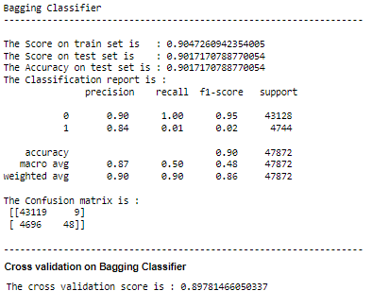
Continued…………….

Slide 12
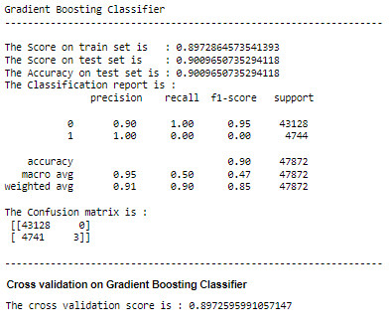
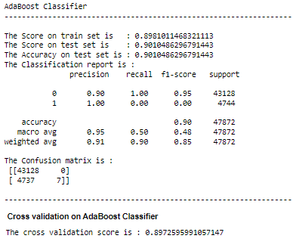
Continued…………….

Slide 13
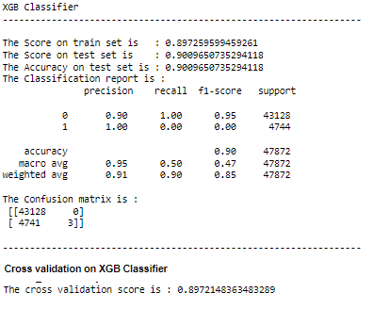

Slide 14
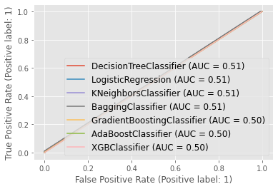
ROC AUC Curve

Slide 15
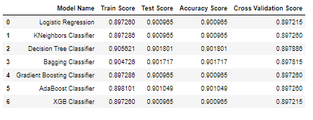
Scores of All Models
XGB Classifier and Decision Tree Classifier models are good. Based on accuracy, Decision Tree Classifier has better accuracy. The difference between accuracy and cross validation score, XGB Classifier has less difference. So final model on this dataset is XGB.

Slide 16
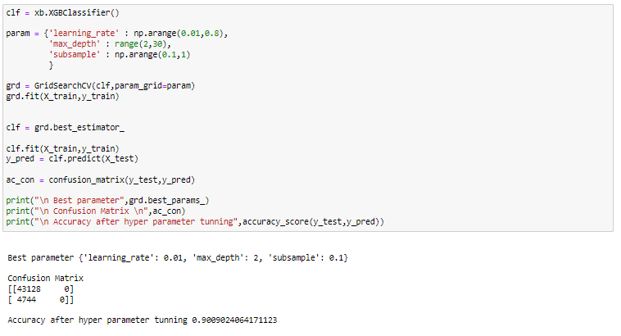
Hyperparameter Tuning
After hyperparameter tuning, not able to improve performance. So, default parameters are best parameters.

Slide 17
Conclusion
This case study provide a great opportunity to take a study view about text processing. In this project, apart from build the model and analysis the data, I also tried to classified hate and offensive comments. By which world can easily controlled and restricted from spreading hatred and cyberbullying.
Dataset is too interesting and from this I can understand whether the online comments are malignant or non malignant.
Initially, data frame is created after dataset loading. Data processing and cleaning are performed to shape the dataset in correct format.
Data cleaning is one of the most important steps to remove unrealistic values and unnecessary stop words.
After cleaning the data, these data are used as input for seven different machine learning algorithms and also tried hyper parameter tuning for building a best model. After that, Based on the comparison of different metrics I concluded that XGB classifier is best performing model with around 90% accuracy.

Slide 18
Thank You………

